Slide 1
FixZak: A Collaborative Approach to Electronic Resource Maintenance
Christian Burris and Steve Kelley
North Carolina Serials Conference
March 10, 2011

Slide 2
Introduction- Basic Information
Z. Smith Reynolds Library
52 full-time staff members
Over 1.7 million volumes
Over 1,800 print journal subscriptions (and shrinking)
Over 50,000 electronic journal subscriptions (and growing)
Over 180 database subscriptions

Slide 3
Introduction- Basic Information
Resource Services Team
Five units: Acquisitions, Cataloging, Collection Management, Resource Maintenance, Serials
16 full-time staff members, 1 part-time
20 student assistants

Slide 4
Introduction- FixZak information
FixZak group
Composition:
Head of Collection Management
Head of Resource Maintenance/Serials Cataloger
Head of Serials Acquisitions
Electronic Resources Librarian
Library Specialist- Serials
First meeting: 2006

Slide 5
History of FixZak Group
Prehistory
Poor communication
Notes:
I’m going to tell you the story of how our group, that we call FixZak evolved over the years. We began with a very disjointed system, but over time, through trial and error, we’ve developed what I think is a pretty good system. I don’t mean to bury you in detail, but I think it might be illustrative to show the circuitous route we took as we found our way.
I’m going to frame this story around the working relationship between myself and Carol Cramer, our Head of Collection Management, who can’t be here today, because she somehow thought it more important to spend her tenth anniversary with her husband. Go figure.
When I started at Wake over eight years ago, I was hired as the Serials Cataloger in Technical Services. Carol was already onboard as the Electronic Resources Librarian, and was in the Reference Department, and mostly worked as a reference librarian. She turned on our access to electronic journals, and I cataloged them, but there was no direct line of communication between us. We never talked about our work. It’s not that we didn’t get along, we were both just following the previously established pattern. That picture up there is supposed to represent us, but they look kinda mad. We weren’t mad, we just didn’t talk. Anyway, in our process at the time, our Collection Development librarian would select titles and deal with the licensing, then she would tell Chris to purchase the title. He would let Carol know to turn it on, and tell me to catalog the title, but there was an odd, pointless gap in the communication chain between the person who turned on access and the person who cataloged the title and made it visible to the public. Oh, not to mention, a systems person was responsible for adding the title to an A-to-Z list for e-journals. All in all, it was a disconnected system, with poor communication channels that led to frequent confusion.

Slide 6
History of FixZak Group
Beginnings of FixZak group
First Link Resolver
Management of Knowledge Base
Beginning of weekly meetings (2006)
Beginning of troubleshooting email listserv (2007)
Notes:
After a couple of years, Carol and I started to talk about how we should have some sort of more regular communication, but we weren’t even sure exactly what information we needed to share, just that we needed to share *something*. Around 2005 or 2006, the library started looking at buying our first link resolver, and Carol and I were brought into the group looking it over, along with our catalog maintenance guy, Waits Raulerson. We soon realized that the degree of maintenance that the link resolver required, especially the upkeep of the knowledge base listing our holdings, was probably too much for any one person to add to his or her job, so the three of us began meeting to handle the management this task. We decided to make it a weekly thing, because we were all learning how to do this, and knew that if we didn’t force ourselves to get together regularly, we might forget how to do this stuff. So we set up a regular two hour meeting on Thursday afternoons, which continues to this day.
At this time, a lot of our work involved resolving problems with broken links to e-journal articles, and helping patrons find what they were looking for. We found out about this from our general “report a problem” feature that is in our catalog, A-to-Z journal list, database list, etc. These complaints were emailed to our systems guys who would send the messages to us. In 2007, we realized that the three of us were fielding almost all the reported problems that were coming in, so we offered to be the first stop for all the “report a problem” emails. We set up a listserv with just three members, Carol, Waits and me, and we called this listserv FixZak. Why FixZak? Well, the Z. in Z. Smith Reynolds Library stands for Zachary, and we have had a tradition of using Zak in naming stuff around the library. Like our email a reference librarian service is called AskZak. The name FixZak has come to be an in-house term for our whole operation of cooperative management of e-resources.

Slide 7
History of FixZak Group
Development of FixZak group
Replacing a member
Expanding the group
Current membership
Notes:
Also, in 2007, Carol moved from Reference to Technical Services, working in our Collection Development unit. She started learning about licensing and began on the path that led her to become our Head of Collection Management.
That same year, Waits left the library to pursue a degree in accounting (I guess the excitement of the library world was a little too much for him to handle). So now, Carol and I were working on the same team and in much more frequent contact, but we were losing one of our FixZak team members. We started looking around our team for a likely replacement. We had to find someone willing to learn the process, who could handle the daunting learning curve involved, and who had the flexibility in their schedule to fit in a standing meeting and new work responsibilities. With those criteria in mind, we invited Linda Ziglar, from our Serials Acquisitions unit to join us. She brought in an understanding of acquisitions practices that we had been missing in the group, which helped us better diagnose problems as they arose.
By 2008, the amount of maintenance work had really grown. By then, we had begun purchasing bibliographic records for electronic journals from a vendor, as well as using their link resolver and A-to-Z list, and each of those services required some maintenance work on our end. So we invited Chris to join our group to help keep up.
That helped for a while, but the amount of maintenance work that we had left Carol with an ever diminishing amount of time for handling licensing problems and other issues, so in early 2009, we were able to bring in a new Electronic Resources Librarian, Derrik Hiatt.
At that point, we had completed our winding journey to where we are now with FixZak, a group of five staff members who handle the ongoing maintenance of our e-journal collections, as well as the troubleshooting of our patron reported access problems. Let’s turn now to talk more about how our regular maintenance process works.

Slide 8
Weekly Meetings
Common framework
Review of work
Distributed assignment of specific tasks

Slide 9
Weekly Meetings
Advantage of having the group: takes the load of e-resource management off of one person

Slide 10
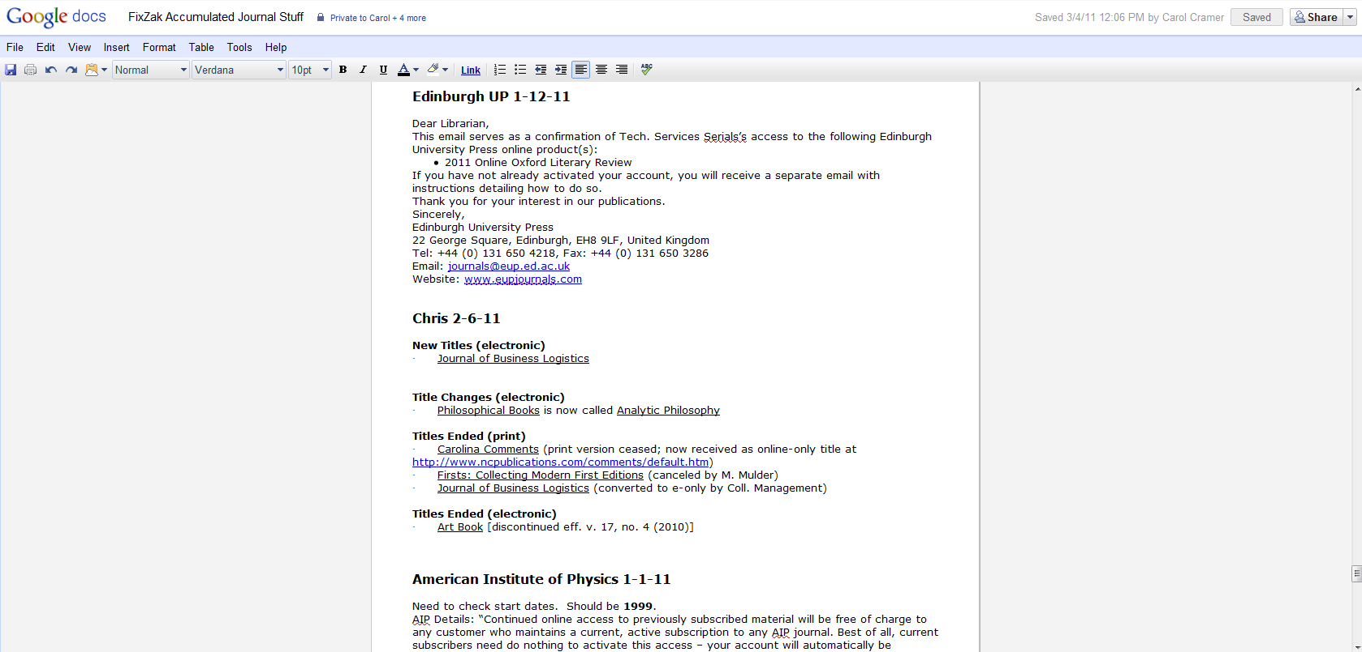
Weekly Meetings
Tools
Google Doc: FixZak Accumulated Journal Stuff
Google Doc: FixZak Accumulated Journal Stuff

Slide 11
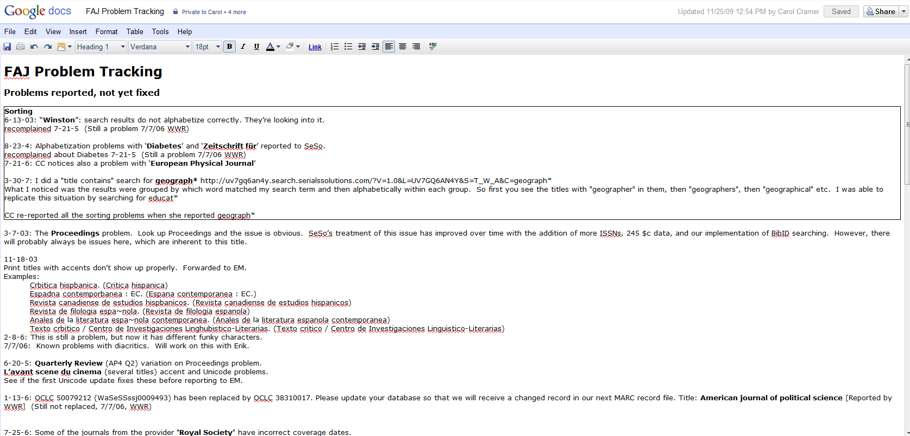
Weekly Meetings
Tools
Google Doc: FAJ Problem Tracking
Google Doc: FAJ Problem Tracking

Slide 12
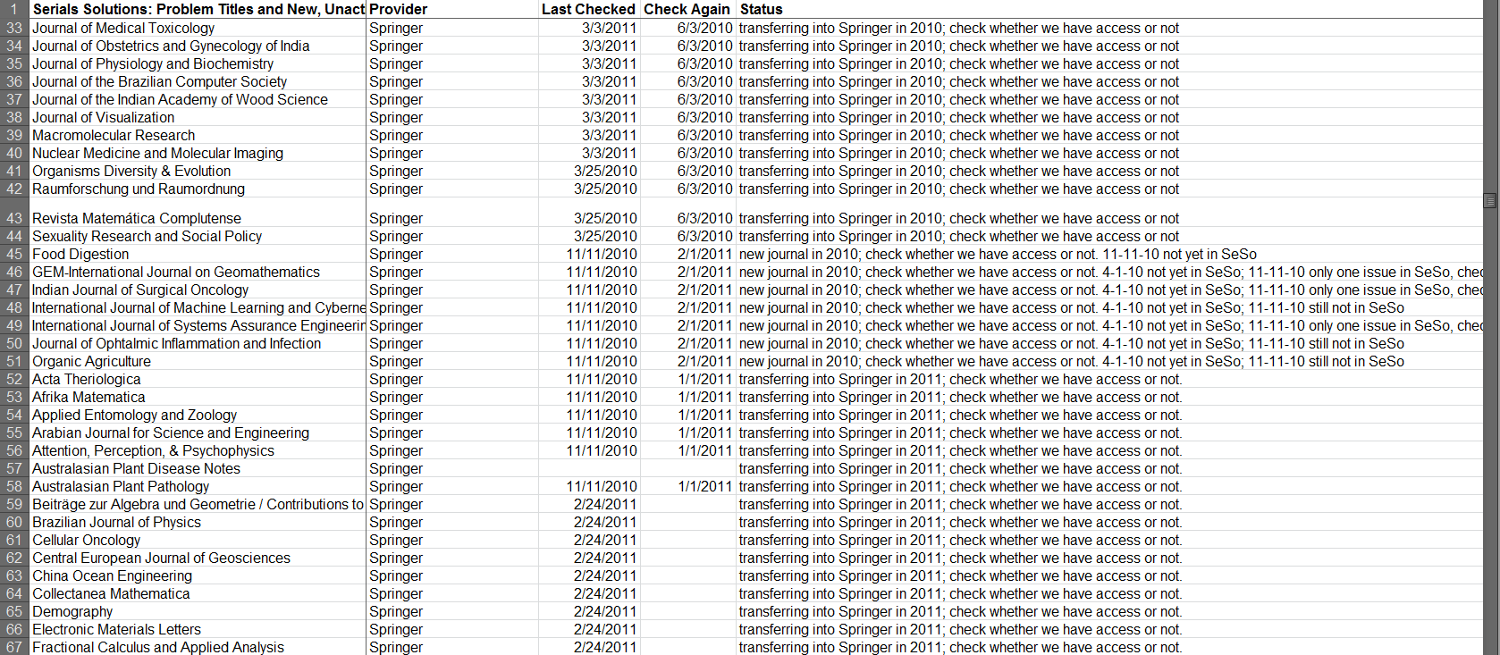
Weekly Meetings
Tools
Spreadsheet: SeSoInProgress (screenshot)
Spreadsheet: SeSoInProgress

Slide 13
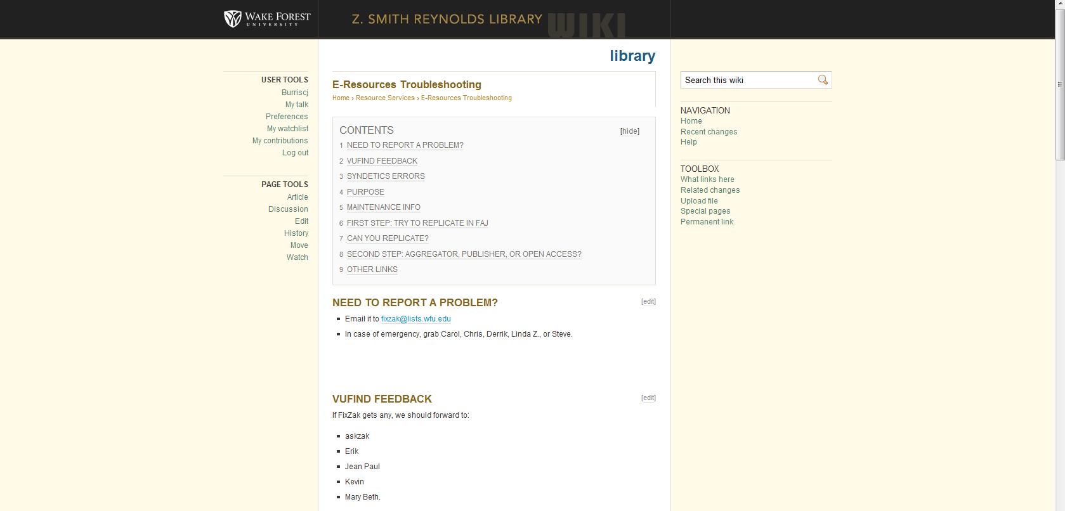
Weekly Meetings
Tools
Wiki: E-Resources Troubleshooting
Wiki: E-Resources Troubleshooting

Slide 14
FixZak Troubleshooting Listserv
Good coverage with five people
Variety of skills to draw on to solve problems
“Outfield rules” regarding who gets what
Average about 10 messages per month
Notes:
As I mentioned earlier, we realized in 2007, within a year of starting the maintenance group, that most of the problems being reported on our library website’s “report a problem” feature were coming to us to resolve. Since we were handling the lion’s share of the problems, it made sense that we just take over the task of monitoring the ‘report a problem’ email list.
This move has given us a number of advantages. We have really good coverage for each problem, because five people see the message. We might have two or three people out, but almost never all five. And rarely four, although we have four people out of the office today, and Derrik is holding down the fort. Everybody has their own way of handling it. Some folks like to have a special sound go off on their email when a Fixzak message comes through, others have the messages go to a particular folder, but we tend to have a set of eyes on each email pretty quickly.
By having people with different primary responsibilities looking at the messages, we can handle any sort of Technical Services related problems that arise. We have people who can handle e-resource licensing, acquisitions, and cataloging problems. We haven’t timed it, but it seems like we get faster turnaround than we did when the systems guys were the initial filter, frequently solving issues within the hour, if not sooner. So our systems guys like this set-up, because they don’t have to mess around with the troubleshooting message, unless the problem has something to do with Systems.
We don’t have a lot of overlap with five people working, or at least less than you’d think. We observe what I like to call “Outfield Rules.” Those of you who know me probably figured I’d find a way to work baseball into this presentation. By “Outfield Rules” I mean somebody calls, “I got it,” and they flag down the problem.
Currently, we get about 10 messages per month, on average. It usually spikes a bit around finals time, as you might expect.

Slide 15
FixZak Troubleshooting Listserv
Common Problems
Bad link to article
Can’t access database, on campus
Can’t access database, off campus
Item is listed has held in OCLC, but not in catalog
Item not shelf
Record doesn’t display properly in OPAC (VuFind)
Errors in bib record
Unsuppressed periodical issues
Two or more items have the same call number
Syndetics data displays incorrectly
Need to renew a book
E-journal asks for password
Need an off-campus login

Slide 16
Lessons Learned
Distributed experience in e-resource management
Huge budget for e-resources, few staff
Weekly meetings help with steep learning curve
Reduces maintenance backlogs that can quickly pile up

Slide 17
Lessons Learned
Distributed troubleshooting listserv gives us good coverage and redundancy
Faster diagnosis = Faster response times
Can identify patterns of problems to fix or address through education of staff and users

Slide 18
Questions?
Steve Kelley – kelleys@wfu.edu
Christian Burris – burriscj@wfu.edu

