Slide 1
The Future of the Library Catalog
Tim Bucknall, UNCG

Slide 2
Traditional Role of the Catalog
Notes:
Before we look at where the catalog is headed, let’s start by looking at where it has been.
Birth – Largely an inventory control tool. First OPAC’s in mid 1980’s. Didn’t really change the role of the catalog; it just took the card catalog and put it online. In the early days, the online catalog was THE electronic tool within the Library. It had virtually no competitors within the library world or outside it. This was a time with no web, no databases, no ejournals. A very high percentage of people who walked in the door used the library catalog. In its heyday, the catalog was the center of Lib’s info universe and the OPAC was its public gateway

Slide 3
Transitional Role of the Catalog
Notes:
Then in the 1990s, electronic resources exploded, and the catalog matured in response.
Really high quality info became available outside the catalog. Catalogers said, “we should include that in our catalog”.
That made the role of the catalog expand. No longer just a list of what the library holds. As quality online content became available, we added MARC records for ejournals, E-books, websites, etc added. At the same time we were expanding the content, we were also enriching the metadata (TOC, book jackets, etc).
These changes wrought by our technical services units turned the catalog into a sophisticated access tool. Online catalogs were no longer merely an electronic version of the card catalog; it was much more.
Sounds great? Right? More types of content, and more metadata relating to that content.
You’d think that dramatic growth in quality and content would mean that library catalogs are the first choice for information seekers. But things haven’t happened that way, have they?
What has happened is that these other data sources have become competitors to the catalog.
It is likely that-
More users get to databases from Google Scholar than from your catalog
More users get to ejournals from Google Scholar or your link resolvers than from your catalog
More users get to ebooks from Google than from MARC records in your catalog
More users get to web sites from search engines than from the catalog
The catalog has competition now as a discovery tool, and it is very fierce competition.

Slide 4
Catalog vs. the Competition
In the 12 years that search engines have been in existence, they have achieved a familiarity rating that is slightly higher than that of physical libraries and considerably higher than that of online libraries.
Source: Perceptions of Libraries and Information Resources, OCLC, 2005, part 1, p 7.
Notes:
Cathy de Rosa
More people are “familiar” with search engines than with either online or physical libraries.
Some times librarians brush that off by saying “ well our quality is much better”

Slide 5
Catalog vs. the Competition
93% agree Google provides worthwhile information.
78% agree library web sites provide worthwhile information.
Source: Perceptions of Libraries and Information Resources, OCLC, 2005, part 1, p 17.
Notes:
It isn’t just that more people think of Google more often than they think of the library. They also think it is Better than the library.

Slide 6
Catalog vs. the Competition
The survey findings indicate that 84 percent of information searches begin with a search engine. Library Web sites were selected by just 1 percent of respondents as the source used to begin an information search. Very little variability in preference exists across geographic regions or U.S. age groups. Two percent of college students start their search at a library Web site.
Source: Perceptions of Libraries and Information Resources, OCLC, 2005, part 1, p 17.
Notes:
If people are more familiar with search engines, and they think the info is a better than the library, it seems inevitable that they’d make this choice.

Slide 7
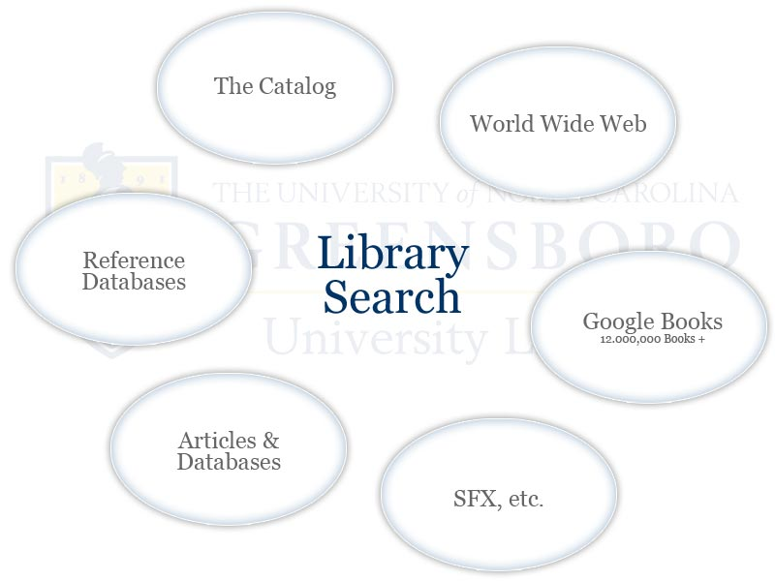
Future Role of the Catalog
Notes:
So what does that say about the future of the catalog?
I don’t think there is anything we can do to the catalog that will make the center of the universe the way it was 30 years ago. It won’t be the ONE search tool the way it used to be. But it can still serve an essential supporting role. Instead of being the ONE place to search, it will be one of the places to search.
It seems likely that we will quit trying to add external content to the catalog and it will go back to being an inventory tool.
Can’t add 12 million Google books – and we don’t need to. Instead of searching them through the catalog and OPAC, we will search them WITH the catalog (but not via the OPAC
RDA facilitates this transition by better exposing cataloging metadata on the open web
Already some products along these lines, Fed Searching has limitations. Discovery tools (EDS, Summon, etc) hold promise but they are very new.

Slide 8
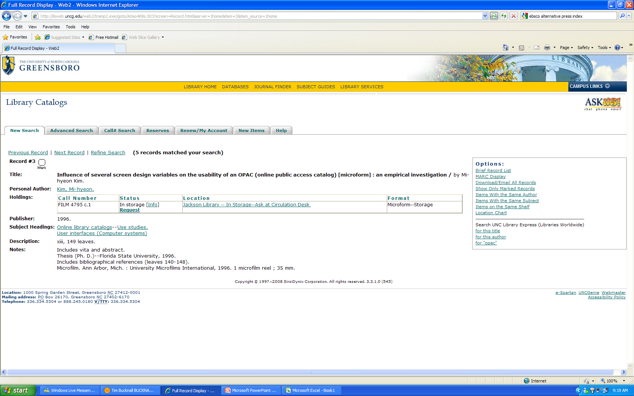
MARC Record
Notes:
Not really a satisfying user experience in today’s world. People expect full text.
Back in the day of the card catalog, people expected and accepted this extra step: there was certainly no expectation that people open a card drawe and actually find the book next to the 3x5 metadata record!

Slide 9
A Growing Gap?
For our users, the most desirable enhancement to the catalog is more links to online content/full text.
Librarians ranked the same enhancement 14th out of 18 choices. Within libraries, directors assigned it the highest priority and catalogers assigned it the lowest.
Data from:
Online Catalogs: What Users and Librarians Want. Calhoun, et al. OCLC: 2009.
http://www.oclc.org/reports/onlinecatalogs/default.htm
Notes:
Compared to our users, we still tend to be more book-oriented and metadata oriented. We are making some progress but change will be incremental, not overnight – at least until Google Books really gets rolled out.
Not saying MARC is bad or un-useful. I’m just saying that it used to be the whole pie and is now a shrinking piece of the pie.

