Slide 1
Online Video Journals and Databases as New Generation of Electronic Resources
Moshe Pritsker, Ph.D.
CEO, co-founder, JoVE

Slide 2
Why the traditional text format is not sufficient anymore
Peer reviewed video journal as a solution
How to building a viable and sustainable video journal
Why YouTube does not work for science communication
Current status of video publication: acceptance in the scientific and librarian community

Slide 3
Scientific Article – same from 1665
First Issue of Philosophical Transactions
of the Royal Society

Slide 4
Typical Scientific Article or Why Text Format does not Work
Position the metaphase spindle at 3 o’clock and hold it with holding pipette. Apply piezo pulses to penetrate the zona pellucida. Touch the metaphase plate with the enucleation pipette. Aspirate the spindle and withdraw the pipette.
What does it say???
How can I use it???

Slide 5
1 picture vs. 1,000 words or why we need to publish in video
Text article
Real life
Position the metaphase spindle at 3 o’clock and hold it with holding pipette. Apply piezo pulses to penetrate the zona pellucida. Touch the metaphase plate with the enucleation pipette. Aspirate the spindle and withdraw the pipette.

Slide 6
The idea of JoVE (Journal of Visualized Experiments)
Text doesn’t work?
Show it in video!
Create new type of science journal:
video journal

Slide 7
Structure of scientific video-article: follow the traditional text format
1. Animated Abstract
2. Introduction of scientists
3. Experimental procedure
4. Discussion of results

Slide 8
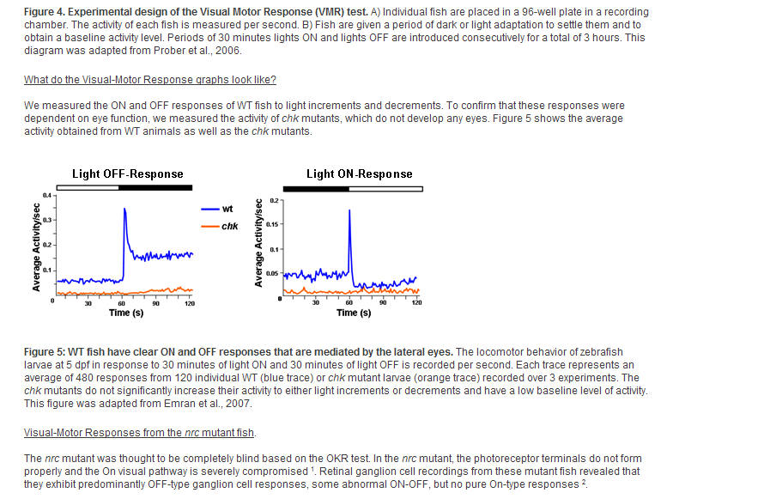
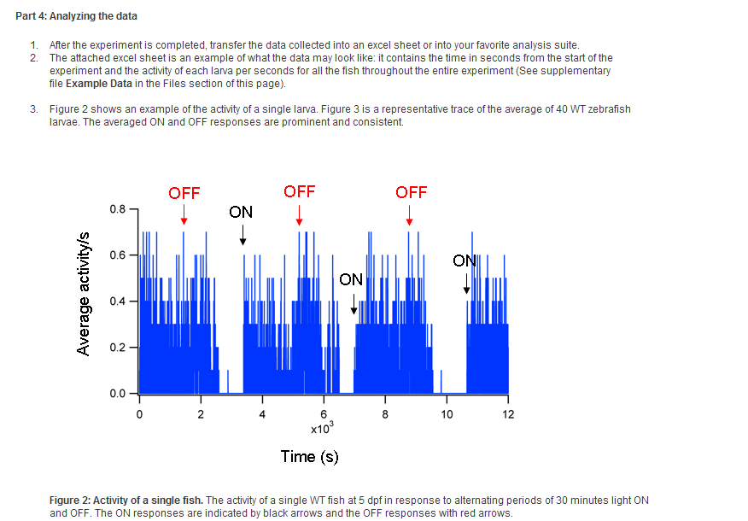
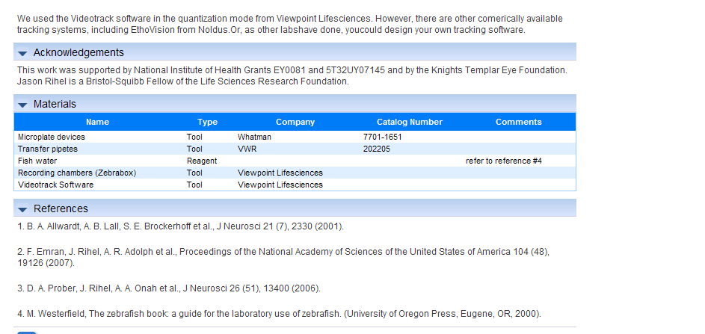
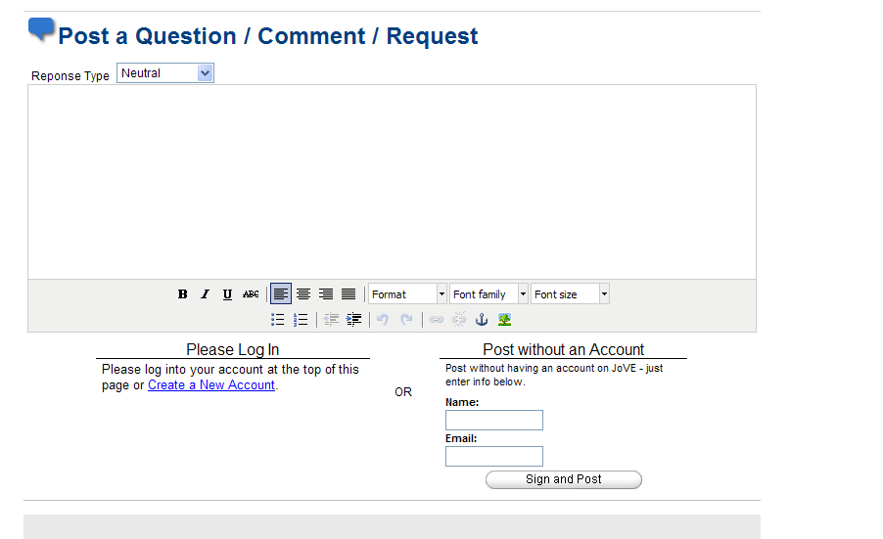
New Article = Video + Text

Slide 9
Why scientists publish in JoVE
Peer reviewed scientific journal, not just a site (publish or perish!)
JoVE provide full video production services
Prestigous editorial board; indexed in PubMed and Medline
Content from top research institutions

Slide 10
We wanted to be accepted so started from the top.

Slide 11
Who publishes what in JoVE?
- Group of Eric Lander (MIT, Broad Instittue) - genomics:
Hi-C: A Method to Study the Three-dimensional Architecture of Genomes
- Group of Rudolf Jaenisch (MIT) – stem cells:
Generating iPS Cells from MEFS through Forced Expression of Sox-2, Oct-4, c-Myc, and Klf4
Group of Arturo Alvarez-Buylla (UCSF) – neural development:
The Subventricular Zone En-face: Wholemount Staining and Ependymal Flow
Group of John Cooke (Stanford) – animal model of disease:
Murine Model of Hindlimb Ischemia
- Group of John Carlson (Yale) – behavior:
Proboscis Extension Response (PER) Assay in Drosophila

Slide 12
JoVE - Current Status
Published 50 montly issues, >1,000 video-articles since Oct. 2006
First video journal indexed in PubMed and Medline
Current rate of publication: 50 video-articles per month. Sections:
JoVE
JoVE Neuroscience
JoVE Immunology and Infection
JoVE Bioengineering
JoVE Translational and Clinical Medicine
5 sections, 10 new articles per each section every month
>200 institutions subscribed (Harvard, MIT, Yale, NIH, Stanford, Duke, UNC Chapel Hill, NCSU, .....)

Slide 13
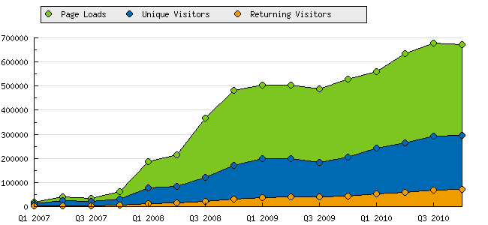
Usage growth
120,000 unique visitors per month
80% from academic instituitions

Slide 14
Example: usage at Duke University > 150 unique visitors per month

Slide 15
Example: usage at UNC Chapel Hill > 200 unique visitors per month

Slide 16
Example: usage at NCSU > 60 unique visitors per month

Slide 17
Example: usage at University of Utah > 100 unique visitors per month

Slide 18
Feedback from the community
Super idea. Excellent movie. Best wishes with your novel publishing concept.
Thomas D. Pollard, PhD
Professor, Yale University
I just viewed an excellent little article on your site, and I would like to include it in the reference materials for my course.
Moses Goddard, MD
Associate Professor of Surgery, Brown University
It is a great way of sharing the kinds of details that make all the difference but are very hard to put into a printed report.
Helmut Hirsch, PhD, Distinguished Teaching Professor, University at Albany
Thank you for creating and developing such an astounding resource for scientists! This is truly going to rapidly advance progress in all fields of research and the potential applications are endless.
Lalitha Chandrasekher, Candidate for PhD Physiology and Biophysics, Georgetown Univ.

Slide 19
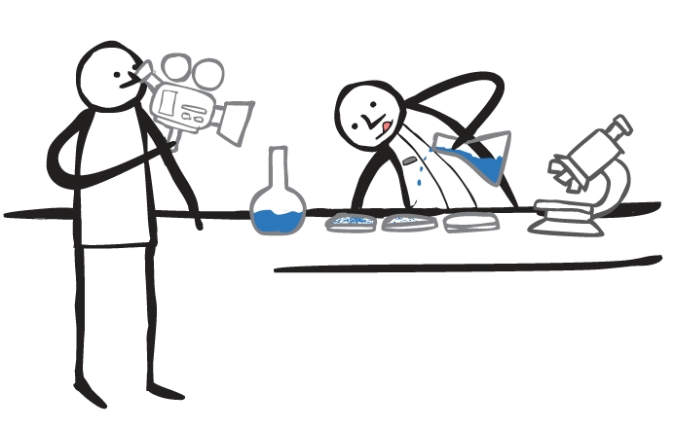
How it works – we make your video for you

Slide 20
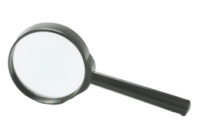
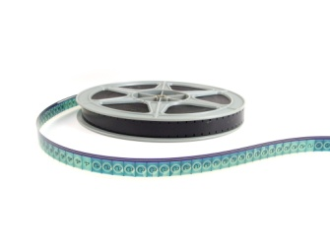
Video production process
Text Protocol
Filming (5h)
Editing
Published

Slide 21
Videographer Network
Countries covered: USA, UK, Canada, Germany, Holland, Austria, Switzerland, Sweden, Denmark, Israel, Japan and Australia

Slide 22
Business model – how to make video journal sustainable
content
JoVE
Scientists
$
$
Libraries
Typical STM publisher model
Break even: Q4 2009
Profitable

Slide 23
Institutions subscribed
>200 institutions subscribed:
Harvard University, Massachusetts Institute of Technology – MIT, Brandeis University, Brown University, Cold Spring Harbor Laboratory – CSHL, Cornell University, Fred Hutchinson Cancer Research Center, George Mason University, Kent State University, Max-Planck-Institute for Medical Research (Germany), Mount Sinai School of Medicine – MSSM, National Institute of Health – NIH, National Taiwan University (Taiwan), Northeastern University of Illinois, Princeton University, Purdue University, Rockefeller University, Salk Institute, UC Davis, UC Irvine, UCLA, University of Verona (Italy), University of Hong Kong (Hong Kong), University of Iowa, University of Miami, University of New South Wales (Australia), University of Southern California – USC, University of Waterloo (Canada), University of Zurich (Switzerland), Vanderbilt University, Weizmann Institute of Science (Israel), Wellesley College, Yale University, Yonsei University (Korea)….

Slide 24
Other video-based models (not journals)
Databases: e.g. Alexander Street Press
aggregates video materials from different sources to create special subject collections in humanities and social sciences
Adds value through video-associated transcription and navigation
Lectures: e.g. Khan Academy, university sites
- lectures filmed and posted online
YouTube-like: SciVee, DNAtube, Bio-alive.com, …..
user contributions and aggregation of videos on science-related subjects at different levels
No peer review or specific format

Slide 25
JoVE as a science journal of new type – what‘s next?
JoVE
JoVE Medicine
JoVE Neuroscience
JoVE Immunology
JoVE Bioengineering
….
JoVE Chemistry?
JoVE Environmental Science?

Slide 26
Question: what do you want for your users – 1 or 2?
1
2

Slide 27
Question B
Do you think scholarly video publication will increase productivity in research and education?
Yes.
No.
Who cares? I am busy saving our print subscriptions.

