Slide 1
Serials Departments Aren’t What They Used to Be: Empowering Users in Times of Need
Denise Branch
Assistant Head Acquisitions & Serials
Virginia Commonwealth University
North Carolina Serials Conference
March 16, 2012

Slide 2

Who We Are
Public research institution
2 campuses
More than 32,000 students
Virtual Library of Virginia Consortium
Serials Team:
-2 library specialists
-1 Serials librarian + 1 Reference librarian
Access to over 58,000 e-serials (paid, free, aggregators & consortium

Slide 3
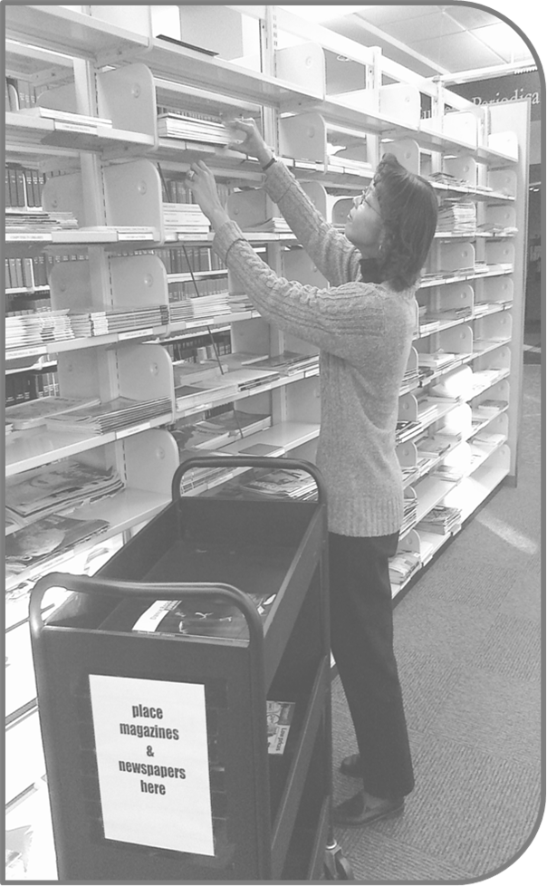
In the beginning there were traditional serials duties
Checking in
Claiming
Binding
Verifying access

Slide 4

How do we empower users in times of need?
The Serials Unit was assigned the responsibility of answering users’ electronic journal problem reports and getting them the access they need.
Provide them with detailed instructions on how to get what they need.

Slide 5
A Little History…
Early 2000s began the cancelling of print and ordering of electronic
In 2004 Open URL link resolver, SFX, implemented
In 2005 a major shift to e-journals

Slide 6
Changes in Employee Work Profile
Employee Work Profile (EWP) 2004: Pre e-serial invasion (No electronic responsibilities)
Checks in & claims periodicals
Maintains current periodical stacks
Checks in government documents
EWP 2005: Beginning of the e-serial invasion (95% electronic responsibilities)
Maintains records for e-serials
Reviews & investigates e-reports
Responds to inquiries regarding access & status of e-resources
Maintains database for license agreements
Processes & claims gov docs
EWP 2011: Total invasion of e-serials ( 100% electronic responsibilities)
Maintains records for e-serials
Manages Open URL link server (SFX) monthly reports
Monitors SFX after installation of updates
Monitors SFX to determine if Knowledge Base has been updated
Responds to inquiries regarding availability and status of e-resources
Maintains database of license agreements

Slide 7

The issues….
No existing mechanism to discover e-serial problems that users were having.
Link resolver, SFX, brought easy access to information. However, access was not always attainable without the intervention and expertise of staff.
Could we use SFX to reveal e-serial problems?
Who would be responsible for helping users get the access they need?

Slide 8

Solution…
VCU Libraries had a history of using electronic forms – logon problems, item renewals, ILLiad.
Best way to address user problems was an electronic form.
Two systems librarians developed an electronic problem report form based on the ILL parser within SFX and a PHP application was created to uncover users’ problems when they use the “Get it at VCU” button.
Serials staff were familiar with troubleshooting subscription problems and had customer service skills. Why not let them handle e-serial problems?

Slide 9
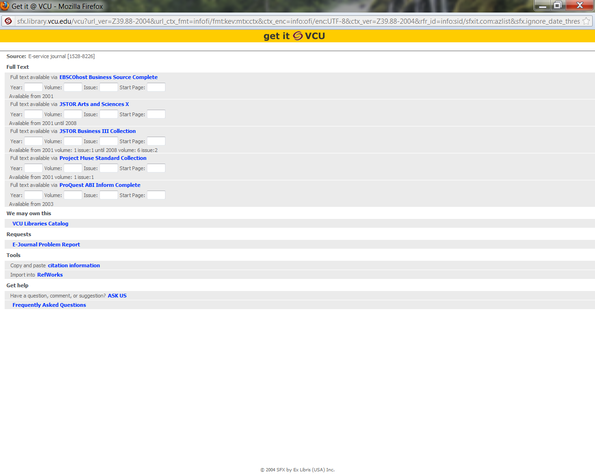
EJPR Request

Slide 10
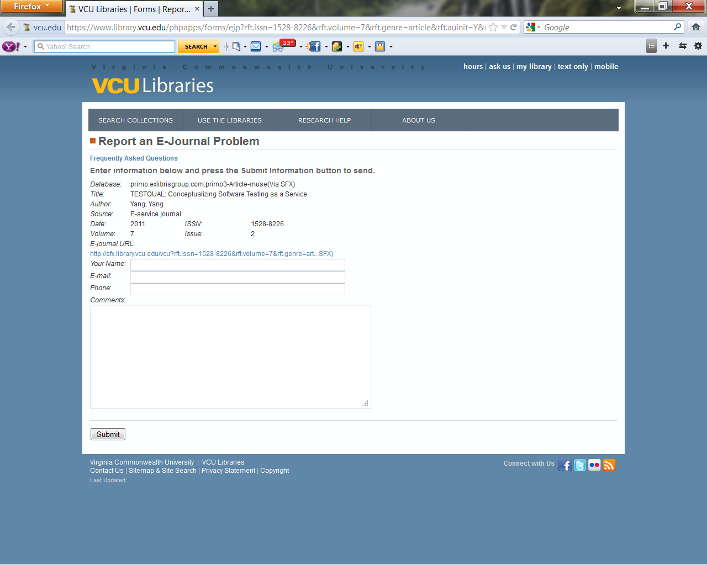
E-journal problem report - EJPR

Slide 11
After creation of EJPR, more issues…
Receiving 2-3 problem reports daily
Easy problem reports:
  5 to 10 minutes to resolve
Complex problem reports:
  Hours to days to resolve
Staff needed training on how to troubleshoot users’ access problems

Slide 12
What training and skills did staff need?
Good communication skills
Interpreting user problem reports
Customer service skills
Link resolver SFX
IPs
URLs
Proxy
Licensing issues
Enhancing technology skills
Troubleshooting skills
Determining who to contact for help with problem resolution

Slide 13
How were training & skills developed?
Brushed up on customer service skills
Enhanced computer skills through practice
Studied SFX manual
Maneuvered around SFX, e-journals & databases
Discussed IPs, Proxy, URLs with systems librarians
Learned successful troubleshooting skills
Shared knowledge among team members
Self-study

Slide 14
Opportunities
Provide users with seamless access & excellent customer service
Discover subscription problems
Develop new skills & enhance current skills
Learn technical aspects of problem resolution
Develop relationships with users
Utilize teachable moments when responding to users’ problems
Collaborate with each other and other departments

Slide 15
Strengths
Home-grown problem report
Team approach
E-mail alerts team of incoming reports
SFX link displays what user saw
Repertoire of standard responses
Archive – problems, responses, users

Slide 16
Challenges
Determining the problem
Figuring out the the logical steps to resolve problems
Writing clear and concise responses
Meeting user expectations

Slide 17
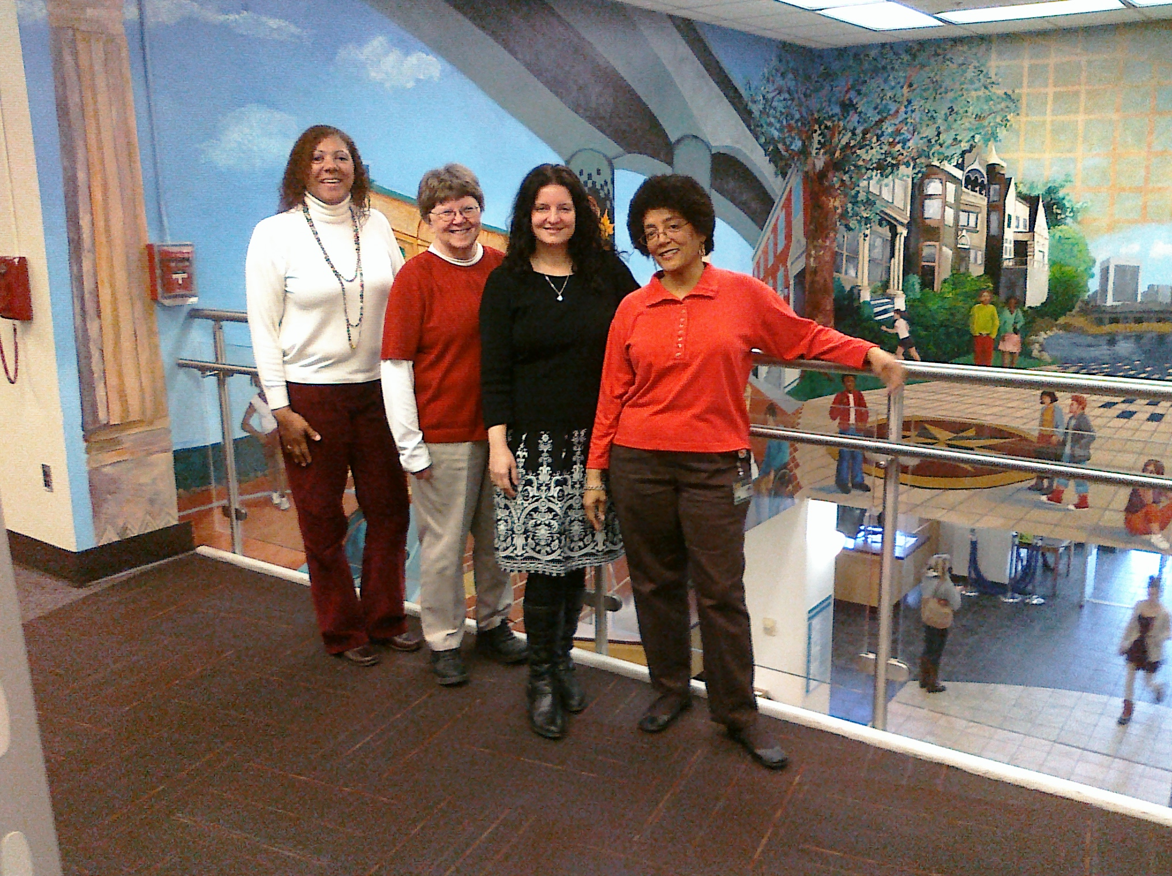
Goals/Measures of Success
Provide seamless access to users
Respond to users within 24 hours
Respond to user first; address underlying problem later
Users do not respond negatively
Users return to the form
Staff are satisfied

Slide 18

Where do we go from here?
Keep up with technology and trends
Continue effective communication & collaboration
Primo – just implemented
Alma – coming

Slide 19
Conclusion
“How we handle our response to their problems may be the only information they have available for forming their opinion of a library staff’s competence and value.”
Schader, Barbara. “Case study in Claiming/Troubleshooting E-journals: UCLA’s Louise M. Darling Biomedical Library.” In E-serials Collection Management, edited by David C. Fowler, 139-158. New York: Haworth Information Press, 2004.

Slide 20
Thank you!
Denise Branch
Assistant Head Acquisitions & Serials Librarian
Virginia Commonwealth University
dmbranch@vcu.edu

