Slide 1
Will Books Be Different?
Kevin Guthrie
North Carolina Serials Conference
March 16, 2012

Slide 2
Overview
Key factors in the transition from print to digital for journals.
How might these factors apply in the book transition?
Will books be different?
nb: there are many types of books. I am talking primarily about scholarly books/monographs
Notes:
2

Slide 3


Journals
Notes:
/

Slide 4
Journals – Important Factors
Journals
Licensing principles
Consortia
.com
PDF
Big Deal
Search/
Google
Preservation
Notes:
4

Slide 5
External Context

Slide 6
Economic context : ’90s and ’00s vs. ‘10s
‘90s and ‘00s
Government money flowed into consortia
Endowment growth in higher ed
Foundations supported transition
Change could be additive
‘10s
Cutbacks in government funding
Cuts to subscriptions budgets
Do more with less
Change must be a substitute
Notes:
6

Slide 7
Web Context: ‘90s and ‘00s vs. ‘10s
’90s and ‘00s
Academic world more connected than consumer world
Academic world “leads”
ISPs? Search Engines?
Consumer web grows from infancy to adolescence
Consumer web has increasing relevance and influence
2010s
Everyone is connected
Scale supports massive commercial investment
Academic world “reacts”
Consumer world dominates
Notes:
7

Slide 8
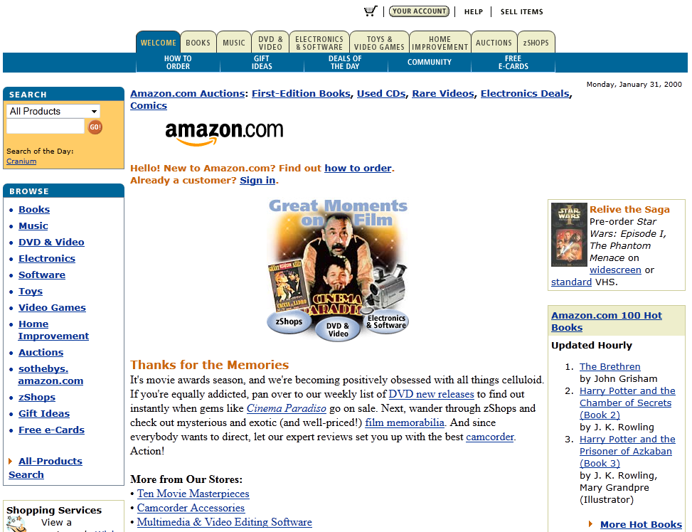
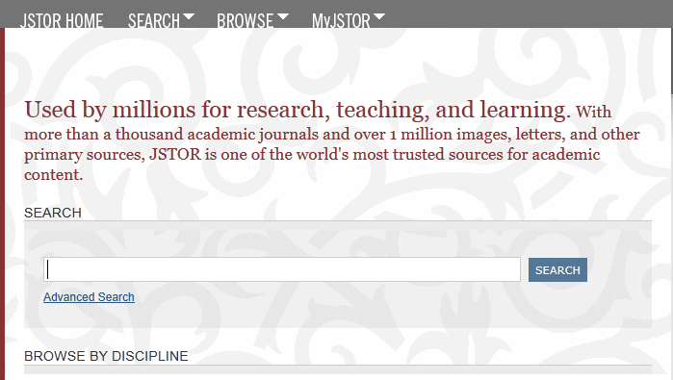
Journals: Influence of consumer internet (.com)
Increased awareness of commercial web → increased usage of the academic web
Notes:
8

Slide 9
Journals: Commercial influence (.com)
Notes:
9

Slide 10
Libraries / Publishers

Slide 11
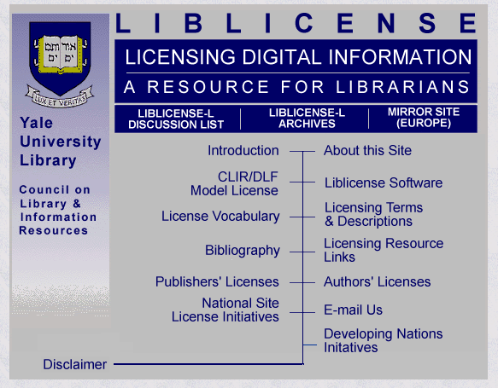
Journals: Licensing Principles
Liblicense project
Shifts in staffing at libraries
Notes:
11

Slide 12
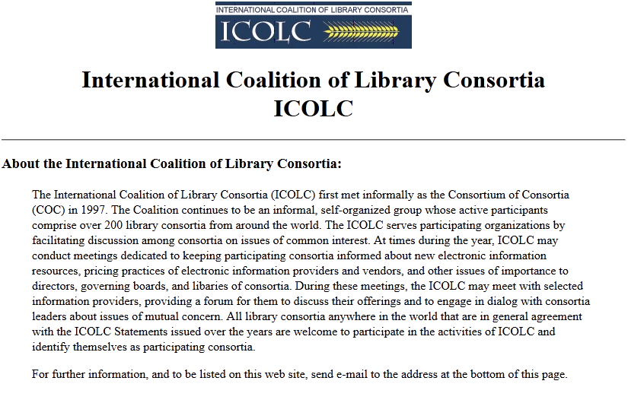
Journals: Consortial Purchasing
COC/ICOLC
Money flowed into the system: from governments, foundations, etc.
Job primarily to negotiate good value for additional content
Notes:
12

Slide 13
Journals: The Big Deal
Consolidation in publishers
More content for the same money
More access for the same money
Lock in and barriers to entry – shifted the unit of purchase from the journal to the aggregation of journals
Notes:
13

Slide 14
Journals: Preservation
Libraries encouraged publishers to participate in various ejournal preservation services
Libraries wanted assurances of long-term access if they were going to be able to realize savings from abandoning print
Ejournals began to be regarded as the primary medium for access to journal content
Notes:
14

Slide 15
Users

Slide 16
Journals: Search/Google
Mega scale products intended for consumer audiences infiltrate scholarship.
Search and discovery: comprehensive search platforms now accommodate all manner of requests
Notes:
16

Slide 17

Journals: Printing
JPRINT vs PDF
Importance of PDF
How is the content “consumed”?
Notes:
17

Slide 18
Ithaka S+R Faculty Survey
Strong agreement with statement: “If my library cancelled the current issues of a print version of a journal but continued to make them available electronically,
that would be fine with me.”

Slide 19


Books

Slide 20
Scholarly Books: Important Factors
Books
Licensing
Consortia
.com
Reading
Device
Big Deal
Google/
Amazon
Preservation
Notes:
20

Slide 21
Books: All books are not the same
Journal Article
Use
Format
Audience
Reference Books
Use
Format
Trade Books
Use
Scholarly Books
Use
Textbooks
Use
Format
Format
Format
Audience
Audience
Audience
Audience
Notes:
21

Slide 22
External Context

Slide 23
Economic context : ’90s and ’00s vs. ‘10s
‘90s and ‘00s
Government money flowed into consortia
Endowment growth in higher ed
Foundations supported transition
Change could be additive
‘10s
Cutbacks in government funding
Cuts to subscriptions budgets
Do more with less
Change must be a substitute
Notes:
23

Slide 24
Web Context: ‘90s and ‘00s vs. ‘10s
’90s and ‘00s
Academic world more connected than consumer world
Academic world “leads”
ISPs? Search Engines?
Consumer web grows from infancy to adolescence
Consumer web has increasing relevance and influence
‘10s
Everyone is connected
Scale supports massive commercial investment
Academic world “reacts”
Consumer world dominates
Notes:
24

Slide 25
Scholarly Books: Influence of the consumer web
The situation has inverted. It is the consumer web where companies are taking advantage of the network and digital technologies in transformative ways
Huge scale. Dominance of mega-companies. Implications for costs of infrastructure and available business models (expensive interfaces, inexpensive/free pricing for access)
The relationship between consumer/trade publishing and academic publishing is very different for books than for journals
Institutions vs individuals
Notes:
25

Slide 26
Scholarly Books: “Google/Amazon”
The Google books project and its audacity made it actually seem possible that all books would eventually be digital.
The growth of these commercial entities have huge implications for the operations of libraries
Increasing focus on what gets accessed versus intrinsic academic or research value.
Search and discovery could prove critical to which books content gets supported.
Notes:
26

Slide 27
Libraries / Publishers

Slide 28
Scholarly Books: Licensing Principles
Libraries want to own books, rather than to license/subscribe to them.
Digital Rights Management
In the institutional setting, what is the interaction between individual access and institutional access?
Adopted titles problem
Notes:
28

Slide 29
Scholarly Books: Consortial Purchasing
Consortia want to “share” books in order to “buy” fewer copies
Not the same receptiveness to the added value that comes with electronic access
Consortia have limited resources and must reduce some expenses to increase others.
Much more complicated choices than negotiating for access in an environment of (even modestly) increased funding
Notes:
29

Slide 30
Scholarly Books: The Big Deal?
Consolidation among publishers
More content for the same money
More access for the same money
Publishers pursuing similar strategies about aggregation for books
Remains to be seen whether similar forces can drive up usage, value and revenue in a more constrained economic environment
What constitutes good value?
Notes:
30

Slide 31
Ithaka S+R Library Survey
Journals
Books
Directors predict a 51%
drop in spending on print journals in the next 5 years…
Directors predict a 31%
drop in spending on print books in the next 5 years…
…bringing budget shares to:
…bringing budget shares to:
/
88% Digital
/
12%
Print
54%
Print
46% Digital

Slide 32
Scholarly Books: Preservation
Remains very important.
Libraries are much more aggressively seeking collaborative approaches for print and digital preservation
Notes:
32

Slide 33
Users

Slide 34
CDL /Springer: UC Libraries Academic e-Book Usage Survey
53% of undergraduates state a preference for print books – a higher percentage than other university populations.
Of stated e-book users, only 35% prefer e-books.
Over 90% of respondents stated that downloading content and search capabilities within the text were very/somewhat important when using e-books in academic work.
68% of respondents found annotation to be very/somewhat important.
Ability to read on a mobile device or e-reader was least important.
http://www.cdlib.org/services/uxdesign/docs/2011/academic_ebook_usage_survey.pdf

Slide 35
Scholarly Books: Reading Device (was Printing, PDF)
Will there be a standard way to consume eBooks for academic purposes that would be akin to what PDF did for journal articles?
Does that require better ways to print cheaply (books print on demand)?
Or does that require that books be consumed in smaller pieces?
Or is it going to require a killer device/reader for academic purposes?
Notes:
35

Slide 36
Ithaka S+R Faculty Survey

Slide 37
Summary of impact

Slide 38
Scholarly Books: Libraries
Substantial Portions of Collection
Scale and economics will force decisions to substitute vs add
Real sense of shifting to service from collection warehouse
Bigger portion of collection; desire to share
  Share costs of print storage
  Share costs of “owning” a book
  Share costs of distributing e-content
Desire to make books access inexpensive for users
Purchase on demand (Patron Driven Acquisition)
  Just in time versus just in case
Notes:
38

Slide 39
Scholarly Books: Publishers
Need to consider multiple formats, devices, business models
Is the academic market insulated from commercial? Do you sell to libraries or individuals?
Do sales to libraries cannibalize individuals (adopted titles)
Publishers already struggling with monographs, what points the way toward this being better?
  Lower costs?
  New market of buyers/readers?
  Ability to sell small portions for small $?
  New business models, i.e. print on demand?
Epublishing favors scale. Publishers band together or seek publishing platforms.
Notes:
39

Slide 40
Scholarly Books: Users
Will Academic users gravitate to e-books the way they did to e-journals
Not easy to consume – print the whole book?
Are smaller units required – chapters and smaller units for new types of course packs?
The devices are not currently fit-for-purpose
How important is annotation?
How important are sharing, social capabilities?
Discovery is a key factor.
Aggregation a key factor. Do I want to access my books on one kind of device, and my other scholarly content on a completely different device or platform?
Notes:
40

Slide 41
Implications
Books are indeed different, as is the environment into which they are attempting to grow and develop
All books are not created equal (novels, pleasure reading, reference, textbooks, monographs, compilations)
Transition unlikely to be comprehensive
Libraries seem to be ahead of users anticipating desirability of eBooks
Transformative use of ebooks for scholarship is going to be harder and slower; look for uses that are evolutionary?
The more important search and discovery is, and the smaller the relevant information item, the faster will be the transition
Notes:
41

Slide 42
Will Books Be Different?
Kevin Guthrie
North Carolina Serials Conference
March 16, 2012

