Slide 1
The (All Too Familiar!) Journal Cancellation Review: Proven Techniques for Eliciting Quality Feedback Susan Swogger Christie Degener UNC Health Sciences Library Chapel Hill, NC

Slide 2
Or, How to Make Acquisitions Cuts and still Keep Your Users Content… if not Happy

Slide 3
Background
The UNC Health Sciences Library’s
on-campus user community includes:
Five Professional Schools
Medicine, Nursing, Dentistry, Public Health, & Pharmacy
UNC Hospitals
UNC Chapel Hill
Notes:
A very large and diverse on-campus community, e.g. (As of Fall 2011) Medicine faculty = 1,611; all of Health Affairs = 2,157; all of UNC = 3.584.

Slide 4
Off-Campus Community
UNC Chapel Hill remote users
Area Health Education Centers (AHEC)
North Carolina health professionals and researchers
North Carolina as a whole
Notes:
Remote users include DE students; students on clinical rotations; UNC faculty and staff working in programs worldwide. The North Carolina AHEC Program meets the state’s health and health workforce needs by providing educational programs in partnership with academic institutions, health care agencies, and other organizations.

Slide 5
CUT
Operating Costs
Staffing
Books & Databases
Building Hours
Technology Costs
JOURNAL SUBSCRIPTIONS
Notes:
In 2009, the libraries were asked to make budget reductions. Cuts were made across all the areas listed but we had to particularly focus on … Journal Subscriptions. [If presenting, only the bulleted list appears initially. Click on any bullet to animate having “Journal Subscriptions” fly in]

Slide 6
Journal Review Models
Past Models
Long, long ago - collected handwritten comments
More recently - posted list with email links
Still good? Maybe not…
Doesn’t work for current user community
Very intensive level of effort needed for analysis
Time to upgrade!
Notes:
We also wanted a model that we could use in successive years; doing journal reviews was viewed as a multi-year process.

Slide 7
Laying the Ground
Library administration
Liaison librarians to the schools
User communities
Asked them what info they want to see
Asked them to confirm criteria, etc.
Alerted them that this would be a multi-year process
Notes:
E.g., we did formal presentations to HSL’s Library Advisory Committee in Feb. 2009 and again in Apr. 2009. (The LAC consists of appointed faculty and student representatives from our primary user groups, the professional schools and UNC Hospitals.) In May 2009 we announced the upcoming Journals Review 2009 website, describing the challenge and the need for input.

Slide 8
Guiding Principles
Be aware of users
Be measured and thoughtful
Be very transparent
Have good communication
Minimize the damage
Notes:
The way our users work is changing: new programs, global efforts, increasingly interdisciplinary and collaborative (both intra-institutional and inter-institutional). Goal was to keep as much valued content as possible while still achieving budget reduction targets.

Slide 9
Selection of Model
Sought a good model evidencing the same principles (transparency, etc.)
Identified a good model almost immediately
Thanks, NCSU!
Notes:
[If presenting, only the black text appears initially. Click on slide title to animate having “Thanks, NCSU!” fly in]

Slide 10
Feedback Mechanism
Worked with IT to build a Feedback Database
Information displayed to users
Title
Publisher
Subject areas
COST
Notes:
Cost is sometimes a controversial piece of information to display. We felt it was important to include, as did the Library Advisory Committee.

Slide 11
Feedback Content
Information input by users:
Status & Affiliation
Journal rating:
Must Keep
Keep if Possible
Can Cancel
Comments!
Notes:
Status and affiliation were required to provide context for the journal rating and comments. Users had option to provide name and email address; quite a few did.

Slide 12
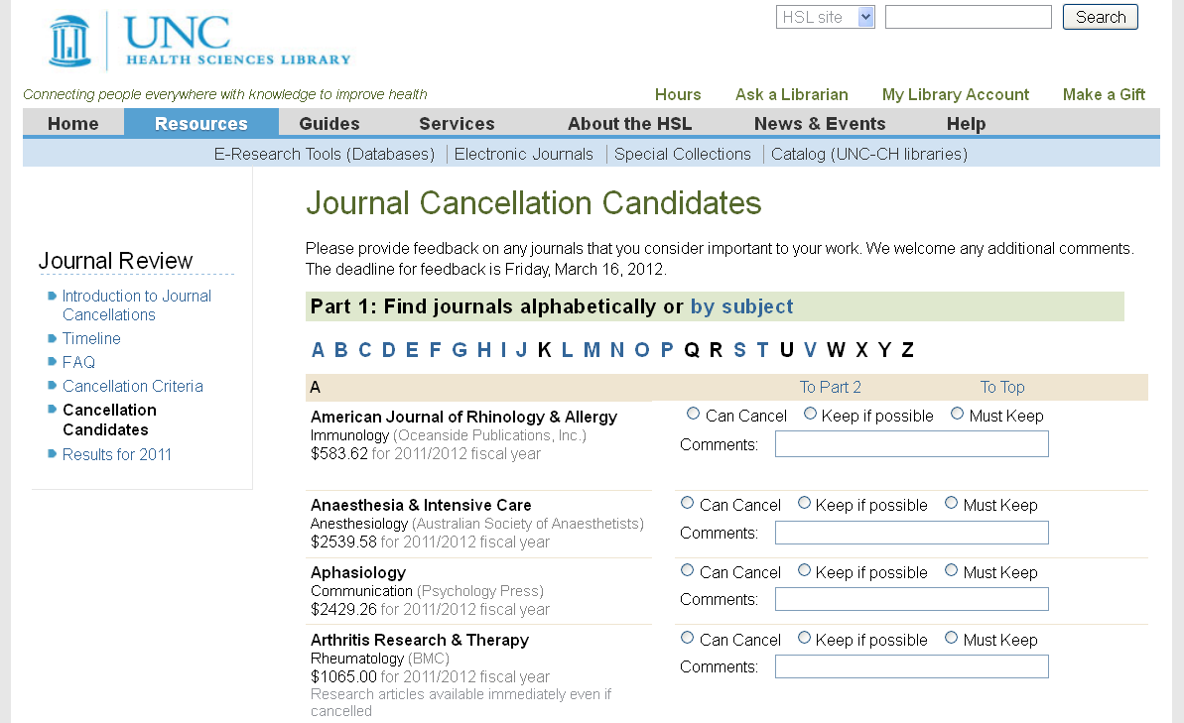
Feedback Form
Notes:
Here’s what users saw from the latest journal review (Summer 2011) . Users could browse by title or broad subject. [If presenting, the candidates list appears initially. Click anywhere on list to show enlarged view of a list entry] Each entry includes the title, broad subject, publisher, and cost. Other notes appeared as appropriate, such as “Delayed access even if cancelled.” Users could assign a rating and add comments for one or more titles as desired.

Slide 13
Journal Review Website
Site Components
Introduction to Journal Cancellations
Timeline
FAQ
Cancellation Criteria
Cancellation Candidates
Results for 2011
Notes:
This website went up early June 2009; we used the same content elements for later reviews. Each link goes to an informational page to keep the process transparent. For example, Cancellation Criteria shows the factors we considered when identifying candidates for posting.

Slide 14
Publicity
Librarian liaison communications
HSL library site & blog
HSL InfoWall
Letter from Library Director to Deans
Broadcast emails
Sent to school communications directors
Sent to other campus librarians
Notes:
Each year we added more approaches: e.g., in 2010 we added a graphical feature on our website; in 2011 we did an exhibit display in the 1st floor lobby.

Slide 15
Triage
Select target publishers
Collect usage statistics
Calculate cost per use
Filter by usage & cost per use
“Low” use – less than 50
High cost per use - $5
High cost per use with embargo - $4
Notes:
Rather than review our entire subscription list we looked at titles from specific publishers, including those having multi-year deals coming up for renewal in 2010. We looked at the 2009 renewal cost and the 2008 usage (the latest complete calendar year), and used these data to calculate approximate cost per use.
We looked at titles with “low” use (less than 50 uses/year) regardless of cost per use. Only 1 title in our group had “low” use.
We defined a “high” cost per use as $5 or above, to have a good pool to work with. These titles were then subdivided into those with high cost per use and “low” use (less than 300 users/year) and those with high cost per use and “high” use (more than 300 users/year). We did this because more than 300 uses/year would start to be a burden for ILL.
We lowered our definition of high cost per use for embargoed titles since some of the demand could be met with free alternative access.

Slide 16
No Feedback Required
Journal is available free online
Journal can be changed from Print / Electronic to E only
Print subscription will continue at another UNC library
Access was interrupted and nobody cared
Notes:
We also identified other print cancellations that didn’t require posting for public feedback.

Slide 17
Analysis
Who responded?
Everyone! All statuses, all affiliations
670 people provided 22,210 ratings
What did they say?
Only 7,546 ratings were positive
Comments were generally thoughtful and on-point
Notes:
The 2009 review ran just 1 month, from June 15-July 15. Despite it being summertime, we got responses from every user status (e.g., faculty, students, residents/housestaff) and every user affiliation (e.g., all the professional schools, the UNC Hospitals, AHEC, the rest of UNC).
Only 7,546 (34%) of the over 22,000 ratings were positive, either “Must Keep” or “Keep if Possible”.

Slide 18
Must Keep!
“This is the standard journal for all major developments in clinical tox -- all of us working in drug development would miss it sorely.”
“Seriously? This is a very important journal!!”
“used for SPHS 813 and SPHS 712”
“This is a vital journal to urology- We read this weekly as part of our journal club. Please keep it if at all possible. We don't know what we would do if it was made unavailable.”
Notes:
While some comments were general, others were very specific about how the title was used for research, patient care, teaching.

Slide 19
Can Cancel!
“Not as important as ES&T”
“Another outrageously priced journal. Maybe if enough universities follow UNC's lead, the journal publishers will be forced to rethink their business model.”
“Not a major player in our field”
“high cost” or similar (many titles)
Notes:
Sometimes users told us another title was more valued, or simply expressed indignation about the cost.

Slide 20
Comment Comparisons
An anonymous pharmacy journal
“this is trashy pharma journal, can lose this one”
“Used both for research and teaching”
An anonymous veterinary journal
“we have no vet school”
“Important journal -- especially for those of us working at the interface of human and animal health, e.g., avian influenza. We published in this last year.”
Notes:
Having the status and affiliation was essential for evaluating the context of the comments, especially when opinions differed wildly.
1st pair of comments: School of Medicine faculty, School of Pharmacy faculty. 2nd pair of comments: Nursing faculty, Public Health grad student

Slide 21
Comment Comparisons
An anonymous physical medicine journal
“important for OT students”
“I'm not sure a $4000 journal dedicated to studying whether my office chair is bad for my back should survive the chopping block.”
An anonymous public health journal
“I've never heard of it...”
“Gives a very valuable Canadian and more international view of public health policy and health promotion that is valuable to American students.”
Notes:
1st pair of comments: School of Medicine student, School of Public Health student.
Opinions could different even within the same user group. The 2nd pair of comments are both from Public Health faculty; one is saying they never heard of the title (not actually a negative), the other much more familiar.

Slide 22
Analysis Criteria
Ratings
Percentage positive, must keep, etc.
Types of comments
Count, apparent source, content, detailed description of how journal is used
Other factors
Audience size, subject area impact, etc.
Notes:
The ratings and comments were captured in a database that generated a variety of analytical views. We looked at each title’s percentage of positive ratings (Must Keep or Keep if Possible) and especially at the percentage for the most positive rating (Must Keep). We looked to see how many comments were made (if any), from whom they were made, and what was said – generic or specific. We also considered whether the title had a naturally small audience which would tend to produce fewer ratings. We also looked at titles within a broad subject category to make sure we didn’t cancel too many in that area.

Slide 23
Outcomes
Journal decisions
Keep
Cancel
“Tier 2”
Total acquisitions budget cut by $330 K
$305 K from journal review Year 1!
$25 K from other efforts
Notes:
The “Tier 2” group was midway between the Keep and Cancel. We kept the titles in reserve in case we needed to cancel more to meet our budget targets. We also looked at them again the next year to see how their usage had changed and whether they should be posted again.

Slide 24
Outcomes
Creation of Journal Review model
Great engagement from user community
Refinement of collection to better serve library community
Only one requested reinstatement!
Confirmation of library as good steward of University & State resources
Notes:
Another outcome is the underlying database and having a great variety of reports for data analysis.

Slide 25
Community Follow-up
Announce & post the results
Make sure they can find the results long-term
Thank the responders!
Give them a clear path to appeal
Make sure they know where to find articles from cancelled journals
Notes:
We posted the list of candidates with decisions.

Slide 26
déjà vu
Year Two & Year Three adjustments
Lower usage thresholds
Smaller review lists
Different publishers & formats under review
Additional data considered:
Embargoed alternative access
Interlibrary loan activity
(In particular) Continued engagement!
Notes:
We did journal reviews in 2010 (Year 2) and 20111 (Year 3). We lowered the usage thresholds to again have a good pool of titles. We had smaller budget reduction targets and thus smaller review lists. We looked at different publishers and expanded the formats. In 2009 we only looked at titles available online. In 2010 and 2011, we looked at print only titles, titles having an embargo period, and titles having a mix of subscribed and OA content.
The journal review process continued to engage: Year 2 – 563 respondents; Year 3 – 346 respondents

Slide 27
Expanded Publicity
Increased web presence
Library homepage image and links
Facebook & Twitter announcements
Links on all library subject Libguides, etc.
Individual notes & signage for each journal under review
Lobby exhibit
Newspaper article
Notes:
Marketing is critical! Users need to be informed to be engaged.

Slide 28
Questions?
Any questions?
Please share your experiences!
Christie Degener, Head of Resources Management Services
christie_degener@unc.edu
Susan Swogger, Collections Development Librarian
sswogger@email.unc.edu
Mike London, Applications Analyst
mikey@email.unc.edu
Notes:
The Database Platform used for this process is Microsoft SQL Server 2000. The website middleware used is ColdFusion. Please contact us to get more details about the database or the process generally.

